Slide 1
Towards Feature Location in Models through a Learning to Rank Approach
Ana C. Marcén, Jaime Font, Óscar Pastor, and Carlos Cetina
5th International Workshop on Reverse Variability Engineering
26th September 2017, Sevilla, España

Slide 2
Agenda
Introduction
The Approach: Learning to Rank for Feature Location in Models (LRFL-M)
Evaluation
Discussion
Conclusions

Slide 3
Introduction
Software maintenance requires, in the first place, to locate the software artifacts that are relevant to the specific functionality.

Slide 4

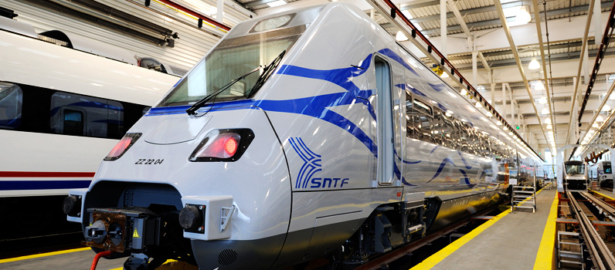
Introduction
Models contains more than 1200 elements that fit around 121 different features.

Slide 5
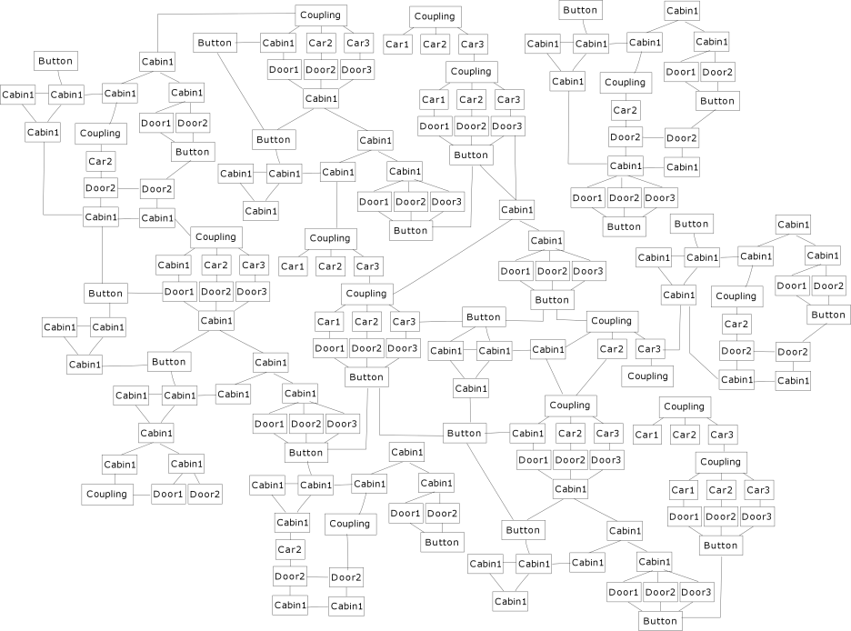
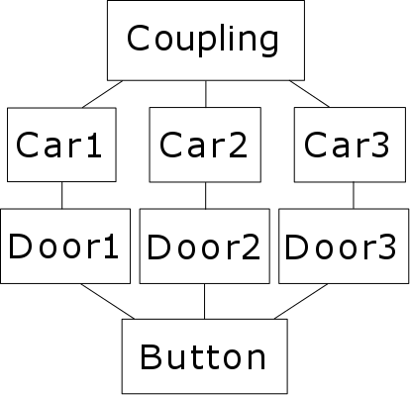
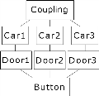
Introduction
The system will turn on the LED of the button that closes the doors on one side of the train if all the doors of the correspondent coupling are closed or blocked.
Models contains more than 1200 elements that fit around 121 different features.

Slide 6


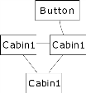

Introduction
The system will turn on the LED of the button that closes the doors on one side of the train if all the doors of the correspondent coupling are closed or blocked.
1
2
3
4
5

Slide 7
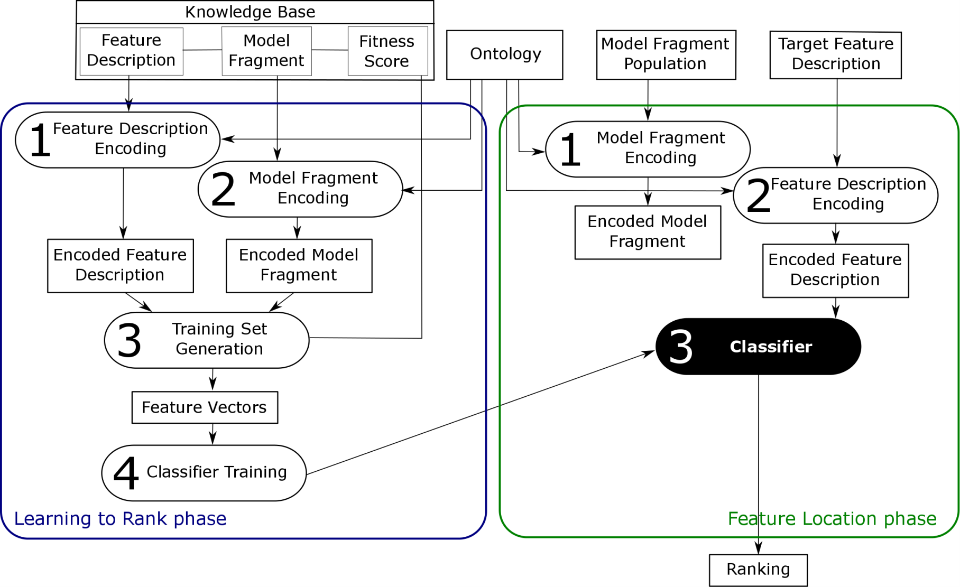
Approach

Slide 8

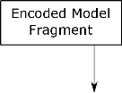

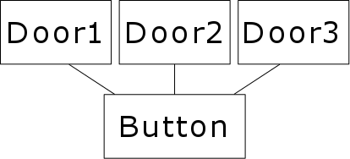
Learning to Rank phase
Inputs: Knowledge Base
The system will turn on the LED of the button that closes the doors on one side of the train if all the doors of the correspondent coupling are closed or blocked.
8

Slide 9
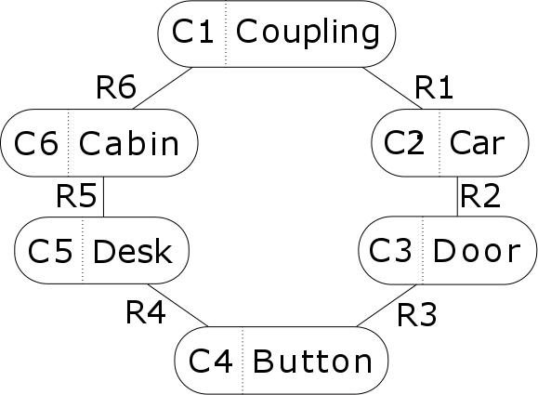
Learning to Rank phase
Inputs: Ontology

Slide 10
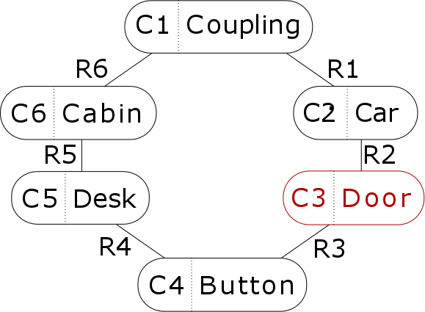


Learning to Rank phase
Feature Description Encoding
The system will turn on the LED of the button that closes the doors on one side of the train if all the doors of the correspondent coupling are closed or blocked.
The system will turn on the LED of the button that closes the doors on one side of the train if all the doors of the correspondent coupling are closed or blocked.

Slide 11
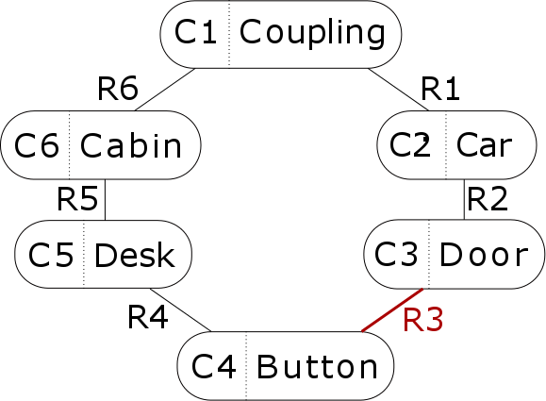
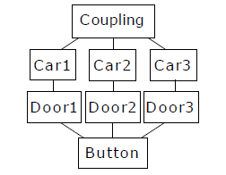
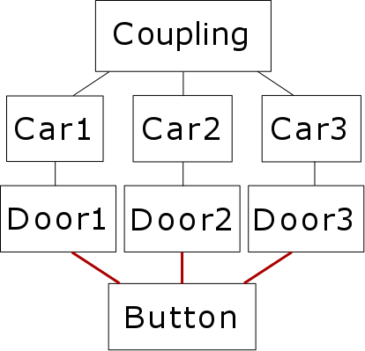
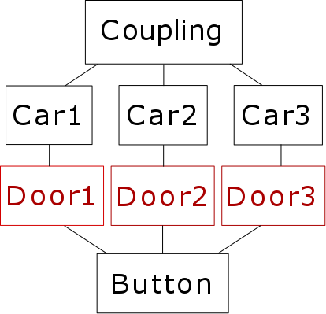



Learning to Rank phase
Model Fragment Encoding

Slide 12


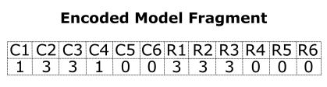
Learning to Rank phase
Training Set Generation & Classifier Training

Slide 13

Learning to Rank phase
Classifier

Slide 14
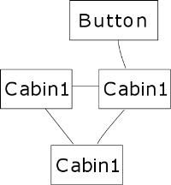
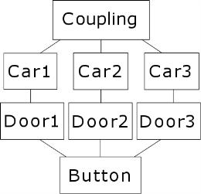
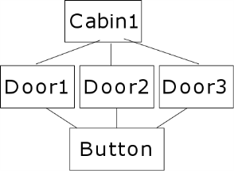
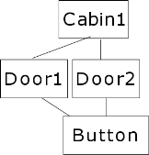
Feature Location phase
Inputs
The system will turn on the LED of the button that closes the doors on one side of the train if all the doors of the correspondent coupling are closed or blocked.

Slide 15
Feature Location phase
Encoding & Classification

Slide 16
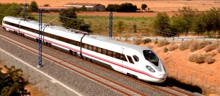



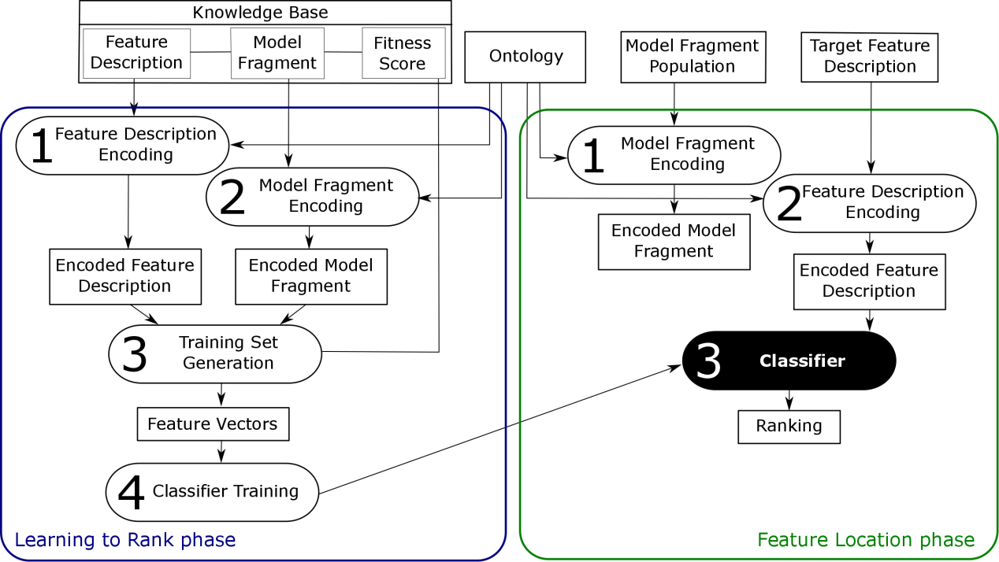
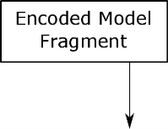
Evaluation
TC1
F1 (1 element)
F2 ( elements)
F3 (3 elements)
F4 (4 elements)

Slide 17
Evaluation
TC1
F1 (1 element)
F2 (7 elements)
F3 (3 elements)
F4 (4 elements)
TC2
F1 (1 element)
F2 (7 elements)
F3 (3 elements)
F4 (4 elements)
TC3
F1 (1 element)
F2 (7 elements)
F3 (3 elements)
F4 (4 elements)
TC4
F1 (1 element)
F2 (7 elements)
F3 (3 elements)
F4 (4 elements)

Slide 18
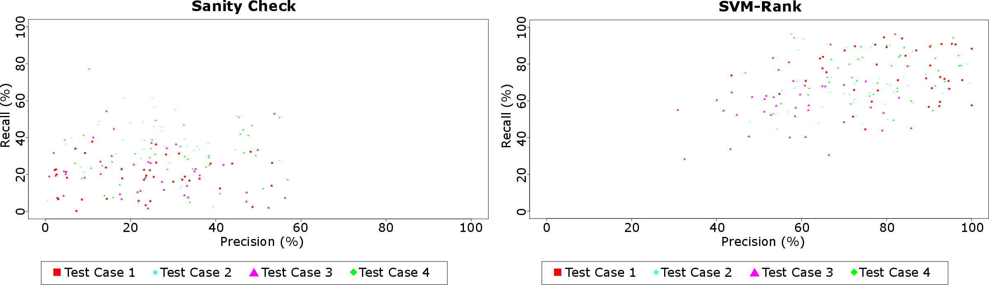

Results

Slide 19
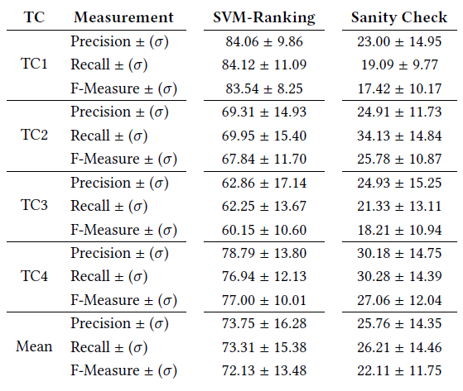
Discussion
Limitations of our ontology-based encoding
The fitness score
The number of elements in the knowledge base
Specific details
The relevance of the concepts and relations

Slide 20
Conclusions
Our approach targets model fragments as the feature realization artifacts using Learning to Rank.
The approach is based on a novel encoding of feature descriptions and model fragments based on an ontology.
The approach takes advantage of legacy artifacts through the Learning to Rank algorithms.
The located features using this approach show recall and precision measures of around 73%, while the sanity check remains below 46%.
Our next steps involve the improvement of the classifier.

Slide 21
Towards Feature Location in Models through a Learning to Rank Approach
Ana C. Marcén
acmarcen@usj.es

